Slide 1
E-Commerce Sales Dashboard
A Power BI Project by Sejal

Slide 2
Project Objective
The objective of this project is to perform a detailed analysis of e-commerce sales data to uncover meaningful business insights.
This dashboard focuses on evaluating sales performance, profit distribution, and customer purchasing behavior across different regions and categories.
It aims to help businesses:
Identify top-performing products, customers, and regions 📈
Track sales trends and profitability over time
Support data-driven decision-making for improved growth and performance 🚀

Slide 3
Tools & Techniques
Power BI Desktop – for dashboard creation and report design
Power Query Editor – for data cleaning, transformation, and loading
DAX (Data Analysis Expressions) – for creating calculated
measures and KPIs
Data Modeling – to establish relationships between tables and
optimize performance
Interactive Visuals & Charts – to enhance data storytelling and
insights presentation

Slide 4
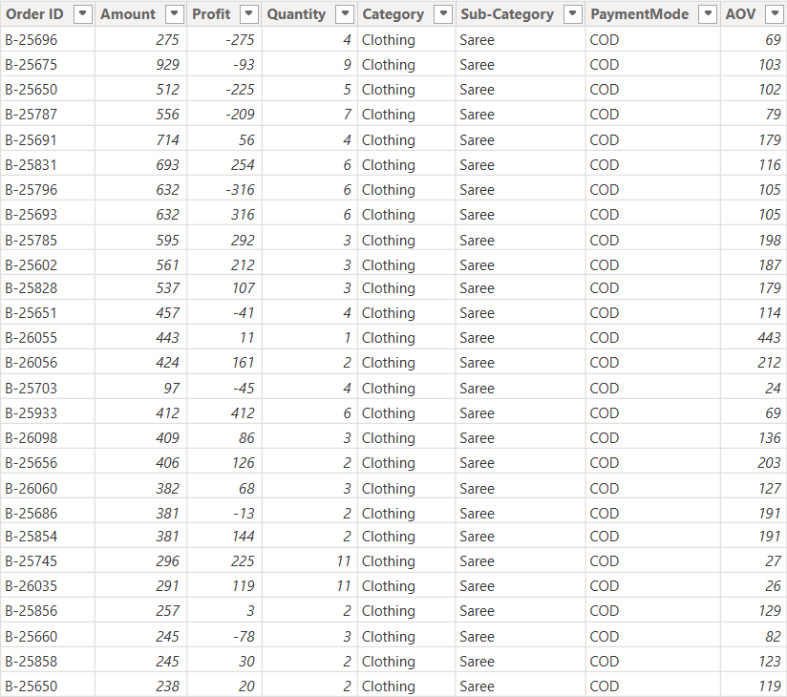
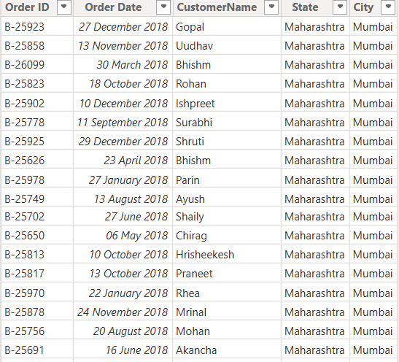
Row Data

Slide 5
Problem Statement
Before creating this dashboard, it was challenging to analyze and visualize e-commerce sales data effectively.
The business lacked a clear view of:
Which products and categories were most profitable
How sales and profits varied across months and regions
Which customers contributed most to the revenue
The impact of payment modes and customer behavior on sales

Slide 6
Project Requirements
This project was designed to answer key business questions, such as:
What is the total sales amount, profit, and quantity sold? 💰
Which categories and sub-categories contribute most to profit? 📊
Who are the top customers by purchase amount? 🧑‍🤝‍🧑
How does profit vary month by month throughout the year? 📆
What are the most used payment modes by customers? 💳
Which states and regions generate the highest profit? 🌍

Slide 7
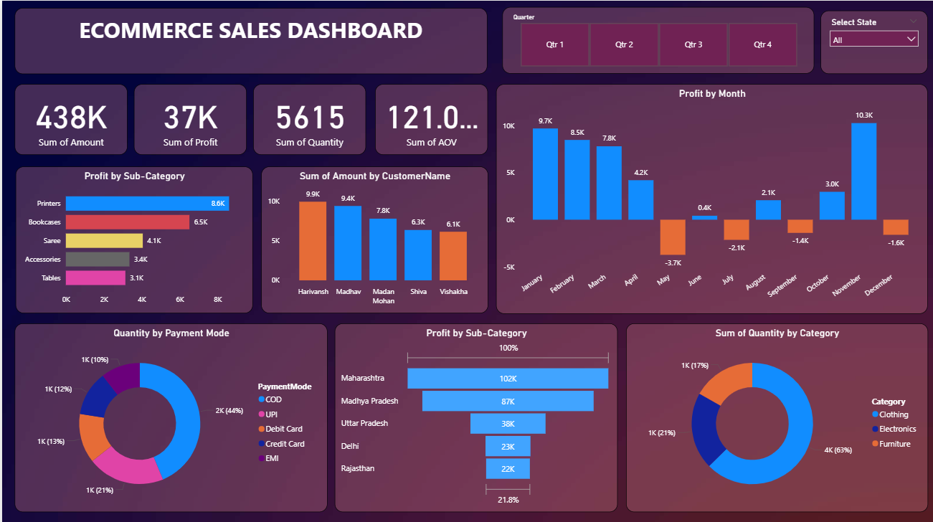
Dashboard

Slide 8
Conclusion
This Power BI project successfully transformed raw e-commerce sales data into a clear and interactive dashboard that provides valuable business insights.
Through this project, I was able to:
Analyze sales performance and profit distribution across regions and categories
Identify top-performing products, customers, and regions
Build a data-driven decision support tool using Power BI
Strengthen my understanding of Power Query, DAX, and Data Modeling
Overall, this project enhanced my analytical and visualization skills, helping me convert complex data into meaningful insights for better business decisions. 📊✨

Slide 9
Thank You

